Slide 1

G2M Case Study
Virtual Internship
10 Oct 2023
By : Mohamed Mohamed.

Slide 2

Agenda
Executive Summary
Problem Statement
Approach
EDA
EDA Summary
Recommendations

Slide 3

Executive Summary
XYZ is a private firm in US that interested in investing in the Cab industry. They planning to choose one of the Pink Cab or Yellow Cab, that according to the G2M strategy.
Great choice : recent ride-sharing market analysis shows the market is expected to increase by a 20% compound annual growth rate (CAGR) between late 2019 and 2025. At this rate, the market will rise from its current value of $61 billion to $220 billion in those 5½ years, an increase of nearly 400%. by Policy Advice

Slide 4
G2M background
Objective : Provide actionable insights to help XYZ firm in identifying the right company for making investment.
Steps :
1- Data understanding.
2- The best profit company.
3- company have more customers.
4- company made more transactions.
5- customers and transactions per city.
6- customers loyalty.
7- recommendations.

Slide 5
Data Understanding :
Cab_Data
Date travelled
company
costy
City
Km travelled
price
Customer_Id
Transaction_Id
Gender
Age
income
Customer-id
Payment
Population
users
Four Data sets : Cab_Data, Customer_ID, Transaction_Id, and City.
- We tried to get the most important features in one dataset, so we can extract a good relation between the two companies.
- The key features cross the datasets are Customer-id and Transactions-id.

Slide 6
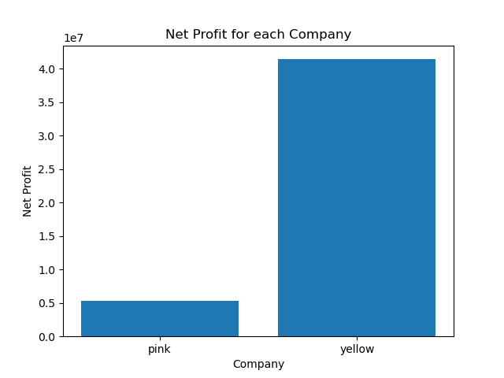
The Highest Profitable Company:
Company Name | Net Profit (2016 to 2018)
Pink Cab | 5,298,655 $
Yellow Cab | 41,419,277 $
- Yellow Cab profit is almost 8x higher than Pink Cab

Slide 7
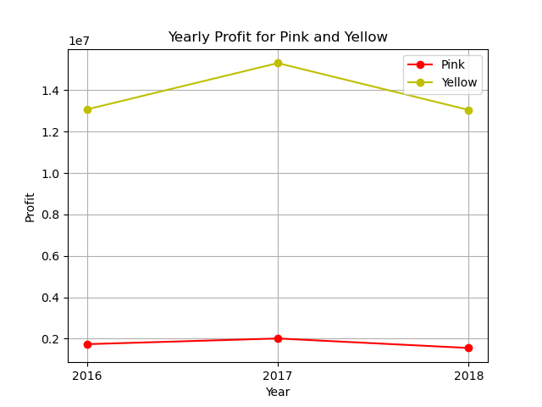
The Yearly profit for each Company:
- There is a big gap between the yearly profit for the two companies. Yellow Cab with the high trend of course.

Slide 8
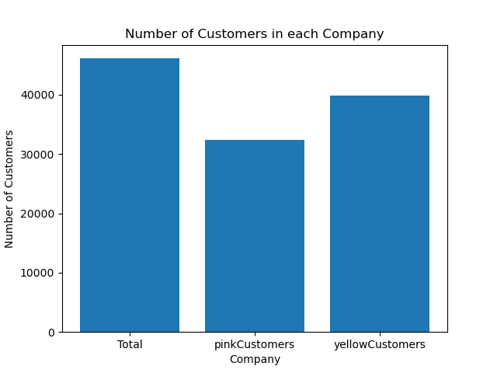
The Company of Highest No of Customers:
Company Name | No of Customers
Pink Cab | 32,326
Yellow Cab | 39,862
Mutual Customers | 26,066
- Yellow Cab have more customers than Pink Cab.

Slide 9
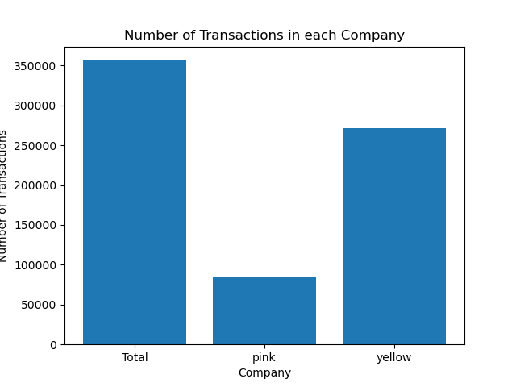
The Company of Highest No of Transactions:
Company Name | No of Transactions
Pink Cab | 84,702
Yellow Cab | 271,563
Total | 356,265
- Yellow Cab did almost 3.5x transactions more than Pink Cab.

Slide 10
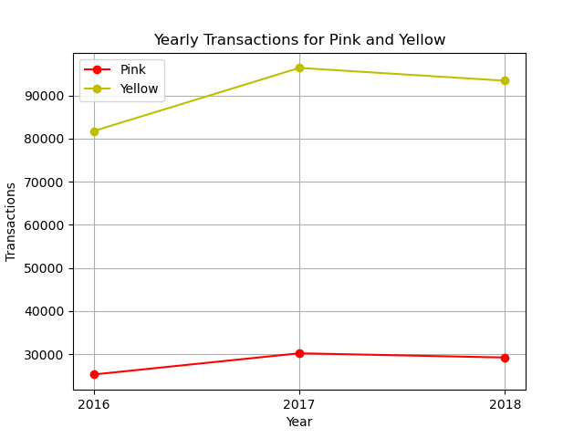
The Yearly No of Transactions:
Company | 2016 | 2017 | 2018
Pink | 25281 | 30201 | 29220
Yellow | 81737 | 96399 | 93427
- Also, here you can easily see the big gap between the two companies in favor of Yellow Cab .

Slide 11
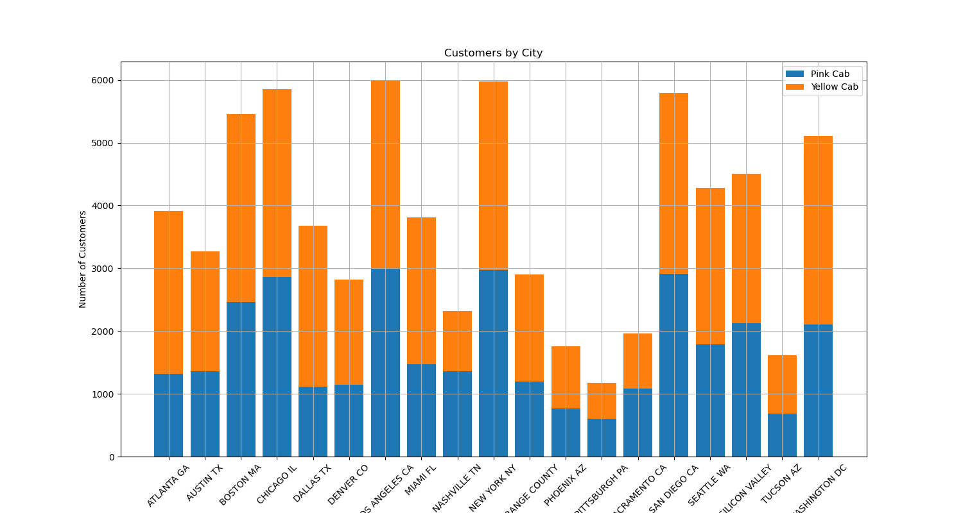
The No of Customers per City:
Yellow Cab has more Customers in all Cities except :
San Diego
Nashville
Sacramento
Pittsburgh

Slide 12
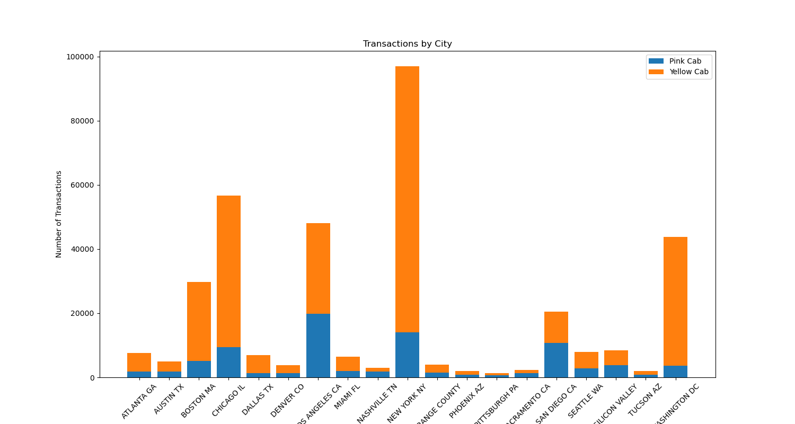
The No of Transactions per City:
Pink Cab has slightly increase in Number of Transactions in these cities :
San Diego
Nashville
Sacramento
Pittsburgh

Slide 13
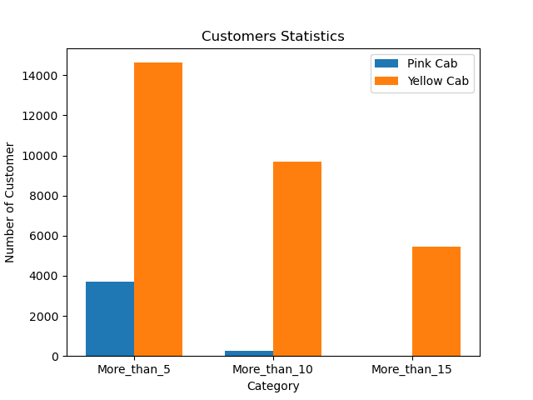
The Customers Loyalty:
- Here we tried to test customers loyalty for each company by counting the number of customers who used the same company more than 5, 10 or even 15 times
Company | Rides > 5 | Rides > 10 | Rides > 15
Pink Cab | 3690 | 240 | 7
Yellow Cab | 14628 | 9707 | 5466

Slide 14
Recommendations:
Based on the data and the analysis we did, we found that Yellow cab may be a better opportunity than Pink cab:
No of Customers & Transactions : Yellow cab has higher customer and Transactions than Pink cab .
Customer Loyalty: We found that customers are more comfortable to keep using Yellow cab than Pink cab.
Net Profit: Yellow cab ’s profit is almost 8 times higher than Pink cab.
City covered : Yellow cab has higher customer reach in 15 cities while Pink cab has higher customer reach in 4 cities.
According to these points we would recommend Yellow cab for investment.

Slide 15
Nice to Work With Your Company
Thank You

